Slide 1


Snyth control® Virtual Pointing System

Slide 2

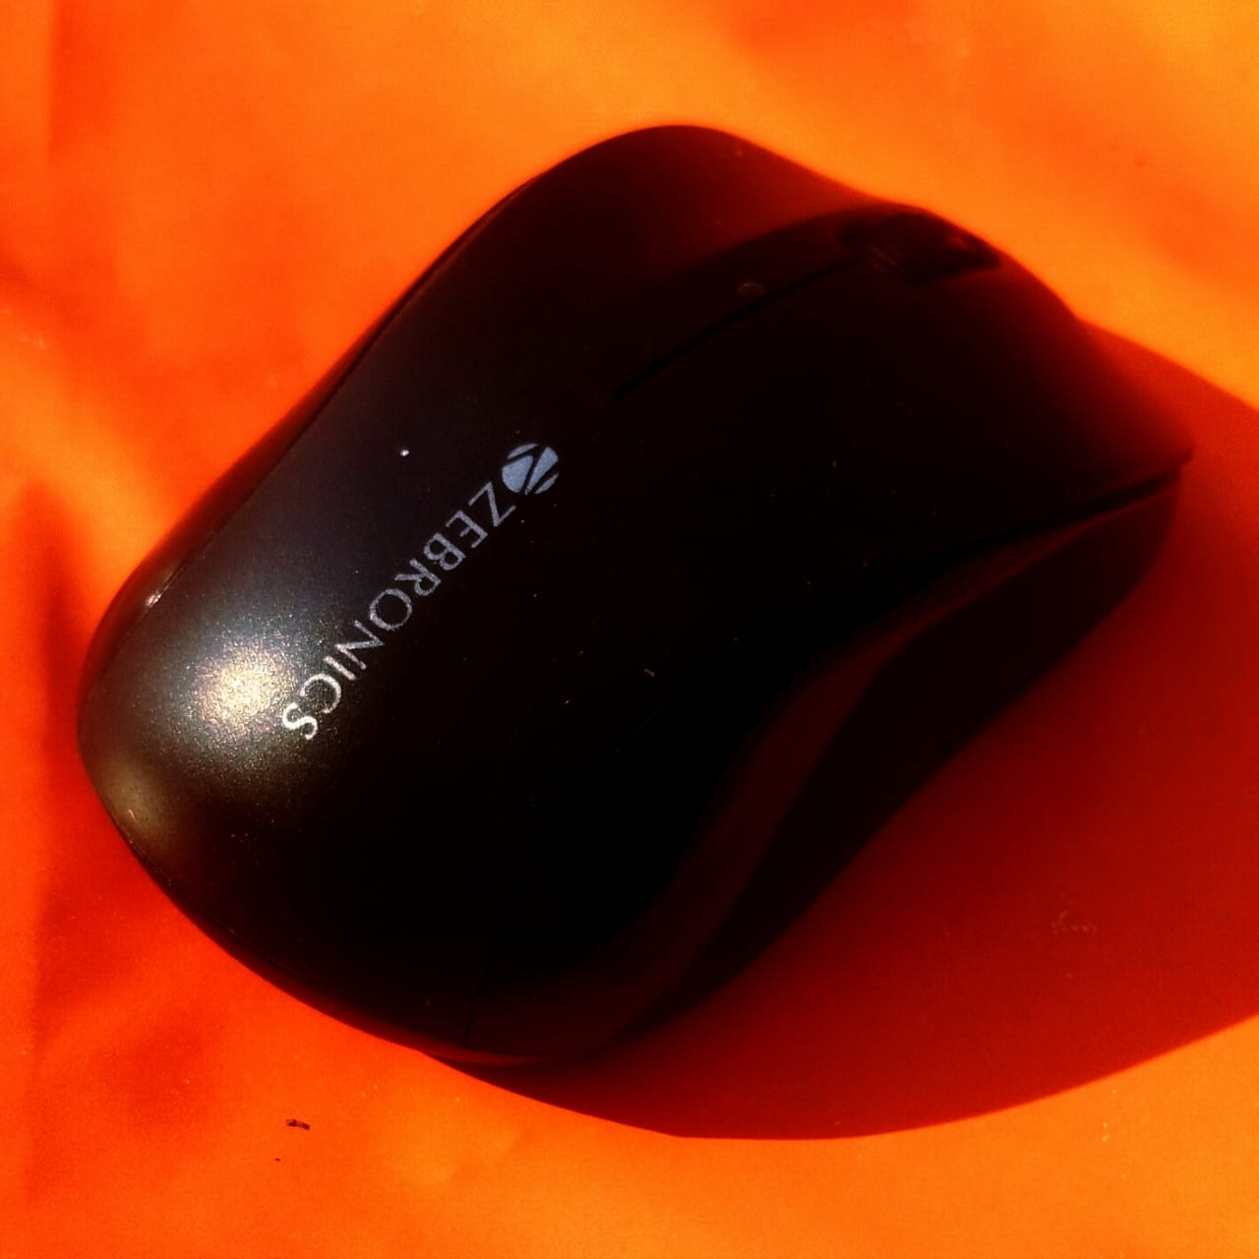
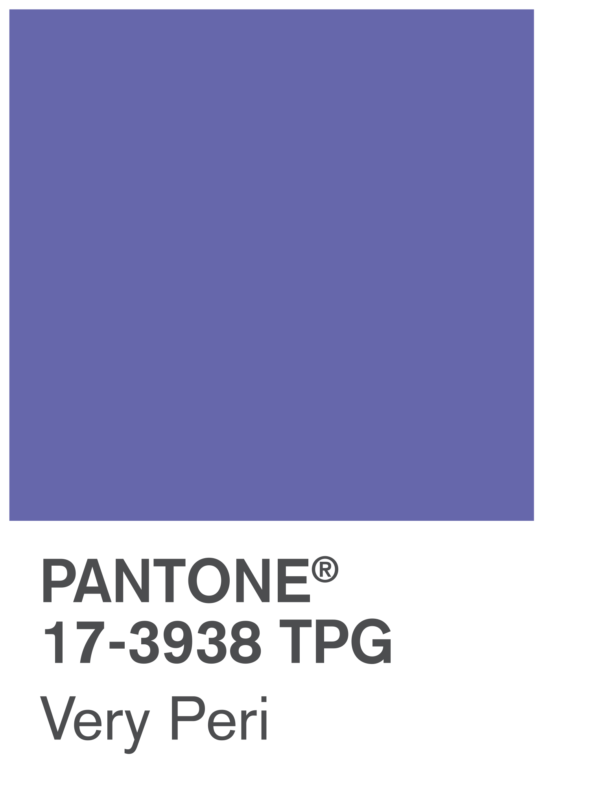
The touchpad tragedy
Recently my touchpad stops working and my interaction with the computer was adversely affected. At last I had to buy a mouse worth 700 rupees. Then my friend suggested me to build something wihich is
Lightweight
Portable
Userfriendly
Free of Cost
The 700 rupees mouse.

Slide 3
Project as product
Later, we conducted an extensive research regarding competitive features of industrial pointing devices and integrated them into ours. Along with some exclusive features that only our product offers like the screen mirroring. Achiving these features, hardware devices would significantly boom the prices while our’s is FREE.
The 700 rupees mouse.

Slide 4
$ The revenue plan $

Slide 5

Fremium Model
Free Tier: Ad banner shall be used to earn profits from 3rd party platforms.
Premium Tier: Special features would be introduced to exclusive members.

Slide 6

Subscriptions
₹ 1 incrementing per month starting with ₹9 (Because 9 rupees won't even buy you a samosa)
₹ 10 incrementing per year starting with ₹99 (best seller)

Slide 7
Purchases
₹500 one-time lifetime purchase (limited period only)
With increasing demand cost shall increase (+5R/20 Customer) to fulfill server.

Slide 8






OEM & Hardware Integration Partnerships: OEM pays a license fee per device: ₹2 Branding deal for “Powered by XYZ virtual touchpad”

Slide 9
Features

Slide 10

What the industry has to provide
BASICS
Scroll
Drag
Cursor
Click
Zoom
Hover
ADVANCED
Gyroscopic Gestures
Volume Control
Shortcuts
Visual/Haptic Feedback
Multi-touch
Gesture Control
Pressure Sensitivity

Slide 11
What WE ADDED
Drawing
Screen Mirroring
Disconnect Locking
Voice Control*
Visual Gesture Control*
*Future Aspiration

Slide 12
Alternate Use cases

Slide 13
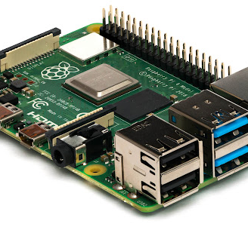
The headless SBC
Any computer requires a monitor for visual output. By this product we tend to eliminate the need of external monitor by streaming screen feed on any touch device.

Slide 14

The Remote help
Digital support providers may utilize our product to access the screen stram and make effects remotely to troubleshoot any potential issues.

Slide 15

Feedback
This product is not just ours but of us all, you can help us with contributing your ideas and suggestions.

Slide 16
Thank you

